Slide 1
Mental Models

Slide 2
Overview
A World of Made Things
How We Learn to Use Things
Mental ("Conceptual") Models
Implementation Models vs. User Models
Why Programmers Are Special

Slide 3

The World of Nature
Visible clues
Physical constraints
Most interactions are obvious
The world our brains are set up for
Thanks to: Donald Norman, “The Design of Everyday Things”

Slide 4
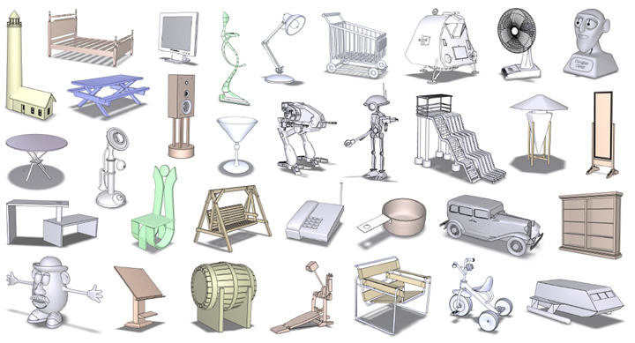
A World of Made Things
Operations may be hidden
A button inside your car opens the trunk ?!
Physical shape may be unrelated to use
Interactions must be learned
Designed by people, for people
Thanks to: Donald Norman, “The Design of Everyday Things”, and http://www.cs.ubc.ca/labs/imager/tr/2008/upright_orientation/

Slide 5
How We Learn to Use Things
Visibility
What controls are available?
What direction do they move?
Any visible responses?
Affordances
How things fit in our hands and bodies
Mapping
This control causes that reaction
Devices that get this wrong can be hilarious
Feedback
Are there indicator lights or a physical change of status?
Thanks to: Donald Norman, “The Design of Everyday Things”

Slide 6
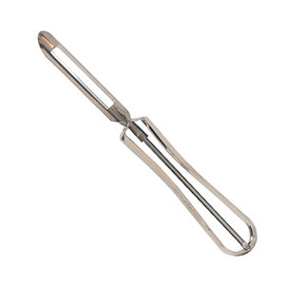
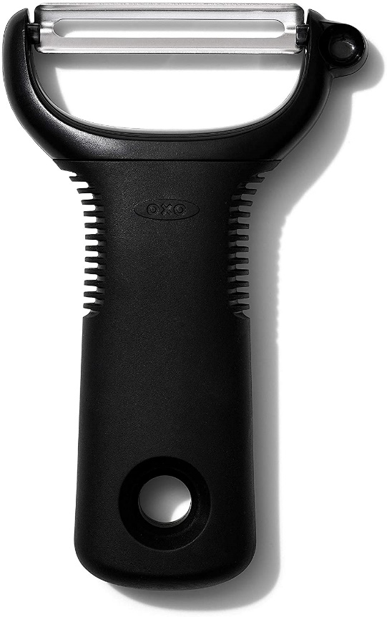
How We Learn to Use Things
Visibility
Affordances
Mapping
Feedback
vs.
Thanks to: http://media.tumblr.com/tumblr_m3fg15nwhJ1r60jgv.jpg and http://lisabonnice.files.wordpress.com/2010/09/oxo-good-grips-swivel-potato-peeler2.jpg

Slide 7
Mental ("Conceptual") Models
Humans create an internal representation/guess about how things work
May not correspond to how things are actually constructed
Not actually a problem, most of the time

Slide 8
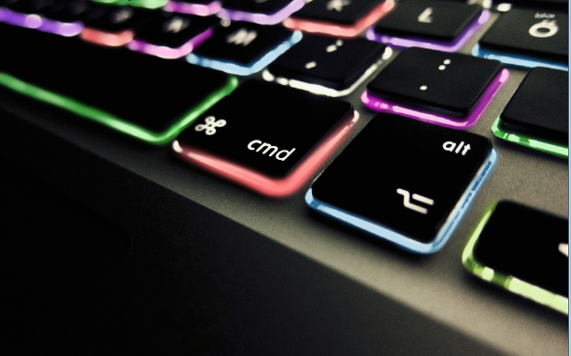
Mental Model: Keyboard
You press a key
The keyboard sends a signal to the computer over a cable with the key you press
The computer says, "Oh, the user hit the 'A' key. Okay."
Easy, right?
Thanks to: http://1ms.net/macbook-pro-keyboard-397975.html

Slide 9
Mental Model: Keyboard
You press a key
The keyboard sends a signal to the computer over a cable with the key you press
The computer says, "Oh, the user hit the 'A' key. Okay."
Easy, right?
But what about the shift key?
Thanks to: http://1ms.net/macbook-pro-keyboard-397975.html

Slide 10
Mental Model: Keyboard
The keyboard keeps track of the shift keys separately. It combines shift and whatever you hit to send the right letter to the computer.
Thanks to: http://1ms.net/macbook-pro-keyboard-397975.html

Slide 11
Mental Model: Keyboard
The keyboard keeps track of the shift keys separately. It combines shift and whatever you hit to send the right letter to the computer.
But what about control/alt/cmd/Windows?
Thanks to: http://1ms.net/macbook-pro-keyboard-397975.html

Slide 12
Mental Model: Keyboard
The keyboard keeps track of shift/ctrl/alt/cmd/Windows keys separately. It combines these and whatever you hit to send the right letter to the computer.
Thanks to: http://1ms.net/macbook-pro-keyboard-397975.html

Slide 13
Mental Model: Keyboard
The keyboard keeps track of shift/ctrl/alt/cmd/Windows keys separately. It combines these and whatever you hit to send the right letter to the computer.
But if you hold a key down, it repeats.
Thanks to: http://1ms.net/macbook-pro-keyboard-397975.html

Slide 14
Mental Model: Keyboard
The keyboard keeps track of shift/ctrl/alt/cmd/Windows keys separately. It combines these and whatever you hit to send the right letter to the computer. If you hold the key down, it sends lots of letters to the computer.
But what if you hit two letters at once?
Hint: this getting complicated/expensive to embed in every keyboard in the world!
Thanks to: http://1ms.net/macbook-pro-keyboard-397975.html

Slide 15

Mental Model: Keyboard
The keyboard lets the computer know when users press down and release keys. The computer figures the rest out.
But now we have a separate wire to every key. That's 104 inputs to an integrated circuit - that's expensive!
Thanks to: http://1ms.net/macbook-keyboard-421330.html

Slide 16
Mental Model: Keyboard
A small IC inside the keyboard is hooked to rows and columns of keys, and scans the keyboard repeatedly, watching for changes in switch positions
The changes in switch position are reported to the main computer
The operating system figures out what's going on and how to respond
But what about keybounce?
Thanks to: http://1ms.net/macbook-keyboard-421330.html

Slide 17
Mental Model: Keyboard
A manufacturing engineer could literally do this all day:
What kind of switches/domes?
Device drivers?
USB packeting, addressing, and signalling?
Eventually, we just want to hit some freakin' keys and have the computer respond
Thanks to: http://1ms.net/macbook-keyboard-421330.html

Slide 18


Mental Model: Keyboard
You press a key
The keyboard sends a signal to the computer over a cable with the key you press
The computer says, "Oh, the user hit the 'A' key. Okay."
Correct
Complete
Useful
Thanks to: http://1ms.net/macbook-pro-keyboard-397975.html

Slide 19
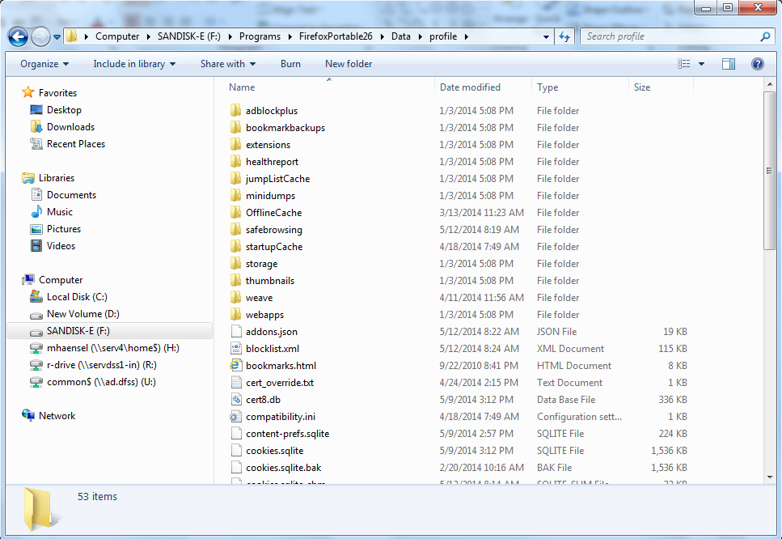
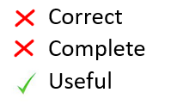
Mental Model: File System
Good devices, especially good programs, help the user develop a mental model of operation
Doesn't have to directly represent what's going on underneath
Does represent the outcome of operations

Slide 20
Why Programmers Are Special
Programmers
Non-Programmers
“How does this work?“
Learn ahead to save work later
Naturally see the implementation model
Just want it to work
Don't want to learn
See only the surface

Slide 21
Conclusion
A World of Made Things
How We Learn to Use Things
Mental ("Conceptual") Models
Why Programmers Are Special

